Slide 1
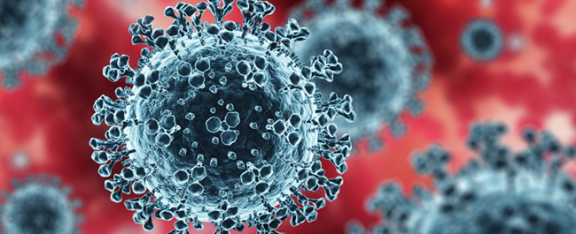
Insight into current COVID-19 variants and data Science Applications
BY:RAVI POTLAPALLI
Professor : Dr. Yixin Xie
BY:RAVI POTLAPALLI
Professor : Dr. Yixin Xie

Slide 2
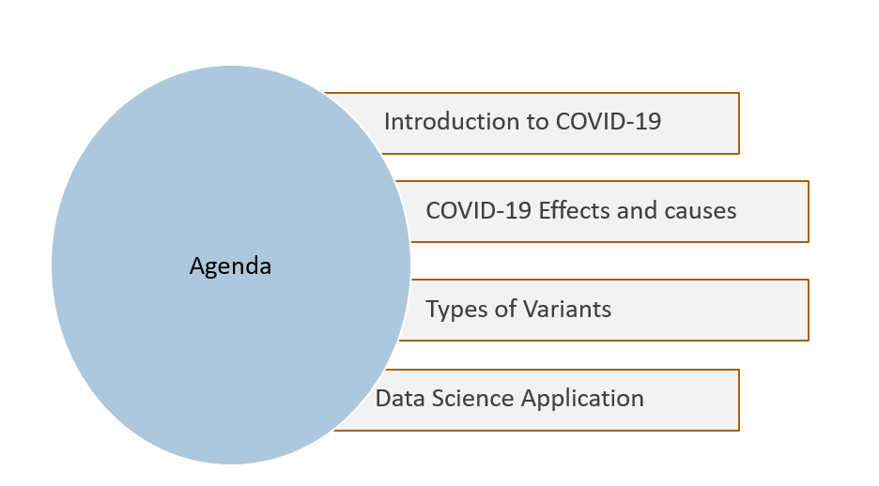

Slide 3

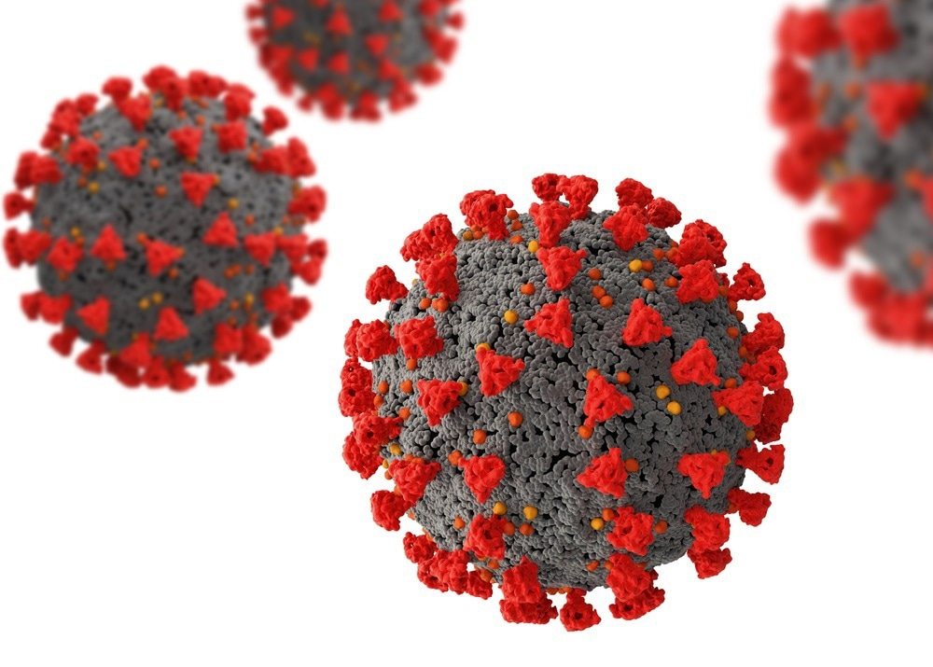
WHAT IS COVID-19?

Slide 4
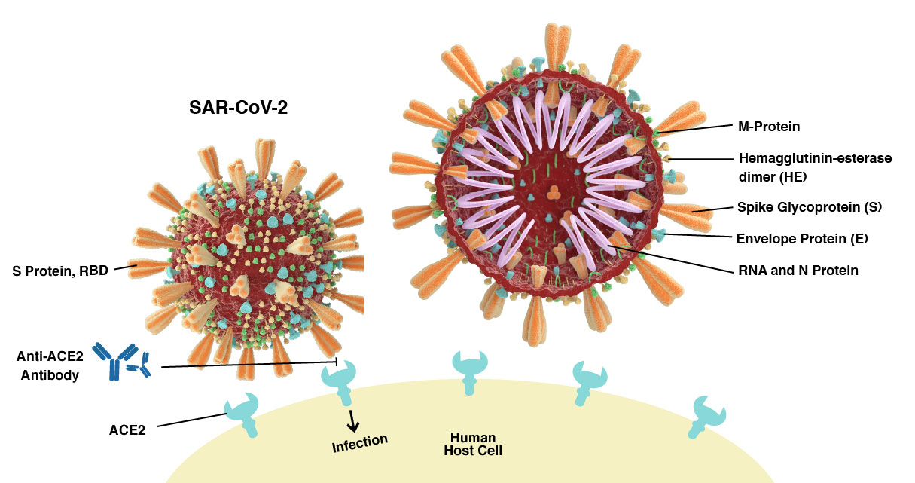
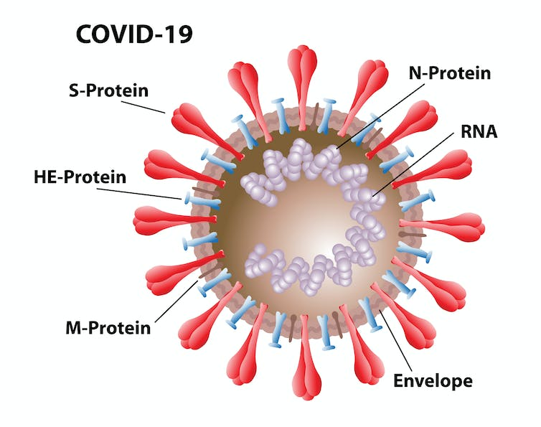
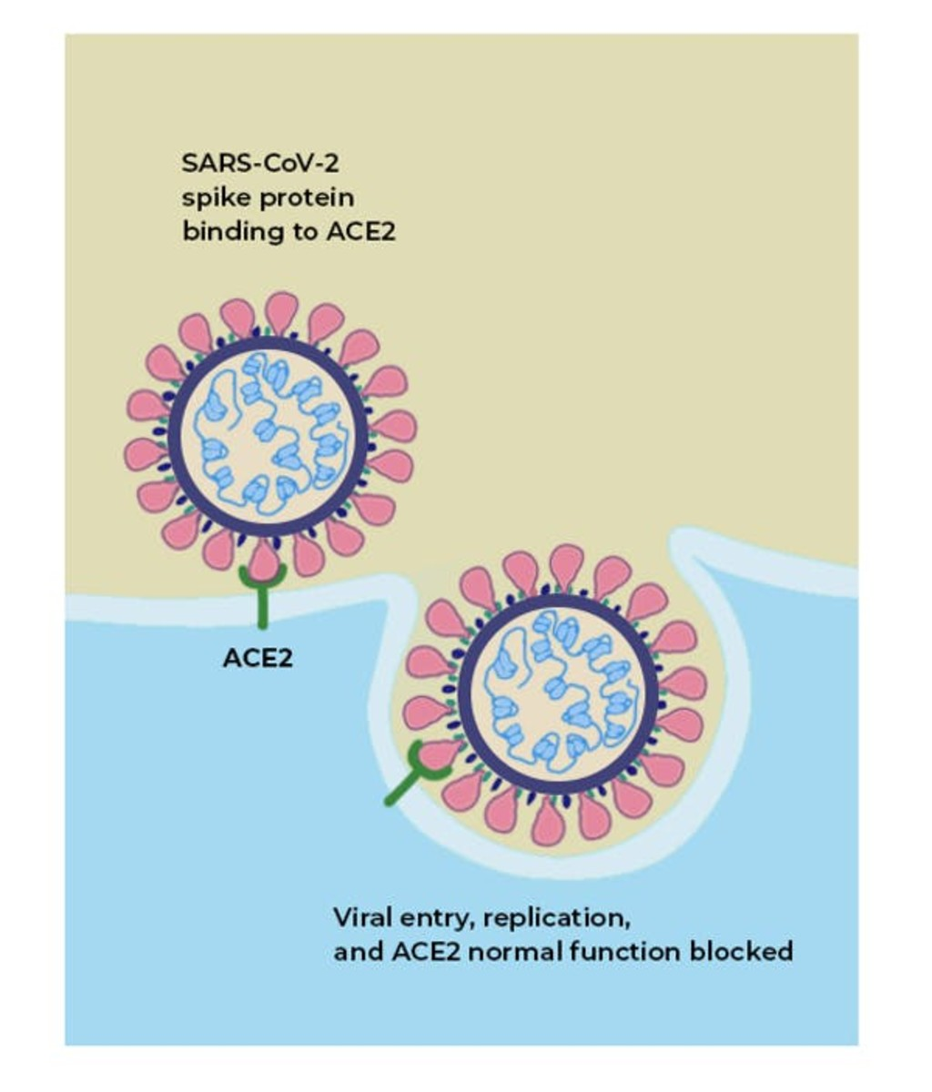



Covid is an infection with the respiratory virus sars-cov-2 that is first identified in the chinese city of wuhan. The latin word "corona," which means "crown," is the source of the term "coronavirus". It was discovered in the year 2019, that is named as covid-19.
The s protein is responsible for binding the virus to the human angiotensin-converting enzyme 2

Slide 5
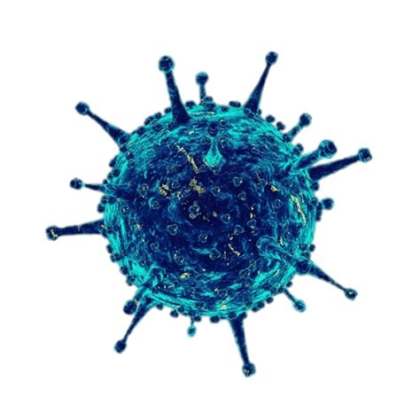
HOW IS COVID-19 Effected and
Causes?

Slide 6
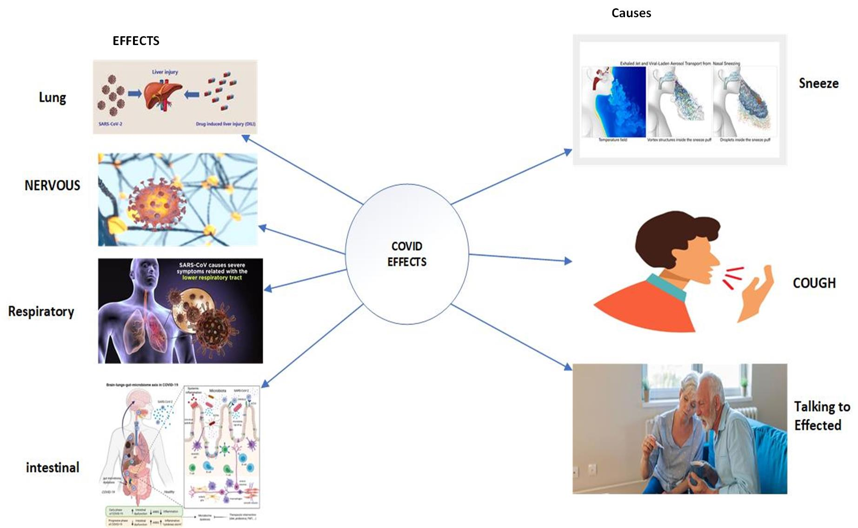
SARS-CoV-2 is a novel coronavirus that infects both humans and other vertebrate animals, causing damage to the respiratory, intestinal, liver, and central nervous systems. It belongs to the CoV's newest evolutionary branch. The virus spreads mostly through respiratory droplets and microscopic particles expelled during sneezing, coughing, or talking by an infected person. In crowded or inadequately ventilated interior environments, the virus can easily spread. Mild to severe illness is possible, though not everyone who contracts the virus exhibits symptoms.

Slide 7
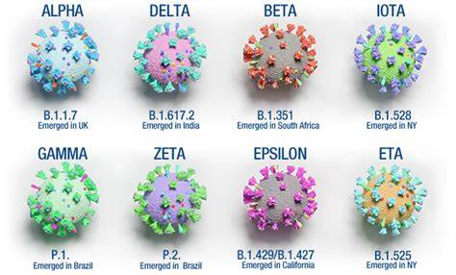
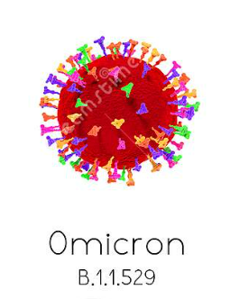
COVID EVOLUTION:
There is changes to the genetic code take place at some stage in genome replication, SARS-CoV-2 is constantly evolving. A lineage is a collection of genetically distinct virus variants that have a common ancestor. A variety of the SARS-CoV-2 viruses has one or more mutations that set it apart from other variants. Recombinant means combining genetic material from two separate variants to form a new variant.
A set of lineages may be categorized as a variant of concern (VOC), a variant of interest (VOI), Variant being monitored (VBM), Variant of High Consequence (VOHC).
Variant being monitored (VBM) and Variant of concern (VOC) has been playing a key Variants in covid evolution.
Some of the most well-known variants of concern include the
Alpha variant (B.1.1.7)-first identified in the UK
Beta variant (B.1.351)- first identified in South Africa,
Omicron variant (B.1.1.529)-first identified in South Africa,
Gamma variant (P.1)-first identified in Brazil ,
Delta variant (B.1.617.2) -first identified in India.
As new variants continue to emerge, ongoing surveillance and monitoring are essential to identify potential public health threats and guide appropriate response measures.

Slide 8
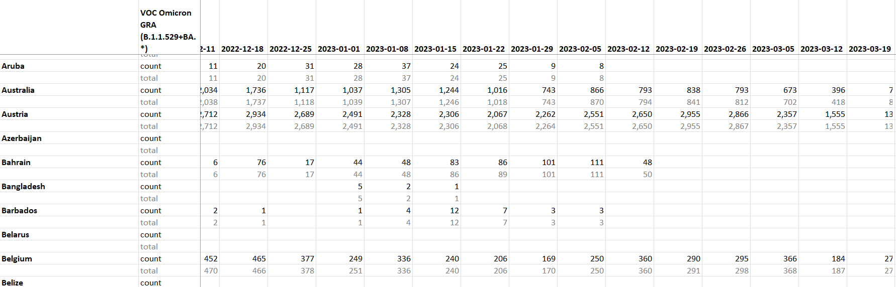
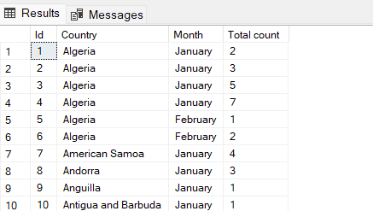
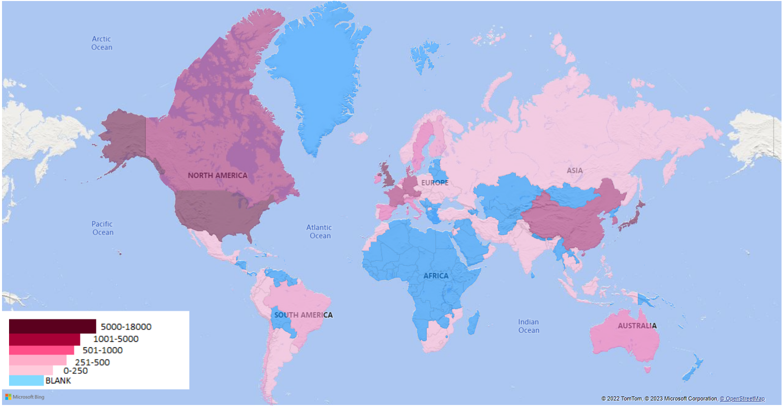

DATA SCIENCE APPLICATIONS
A widespread viral spread throughout the world, including in the United Arab Emirates, Italy, the United States, Spain and the United Kingdom. This spread lead to various cases in Data Science Applications.
In examining the effect of no. of peoples in a city or smaller country, agent-based models are useful because of their flexibility and high granularity in modelling travel patterns. to better model the travel tendencies in a city, census and demographic data are required, especially when individualized mobility data are absent.
Original Data
SQL Data
Power BI

Slide 9
Geographical Design for Omicron 2023(Jan)

Slide 10
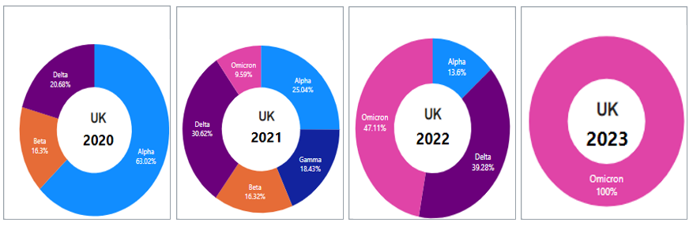
Dominant variants with respect to years(UK)

Slide 11
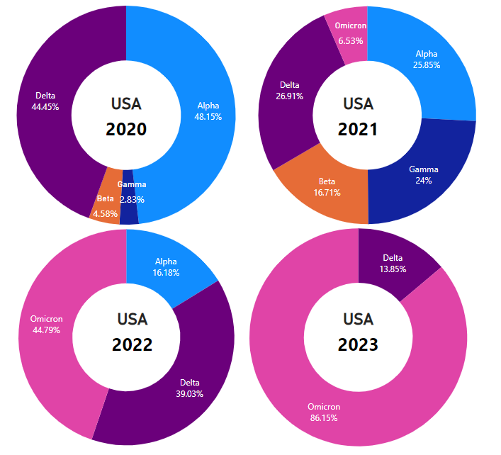
Dominant variants with respect to years(USA)

Slide 12
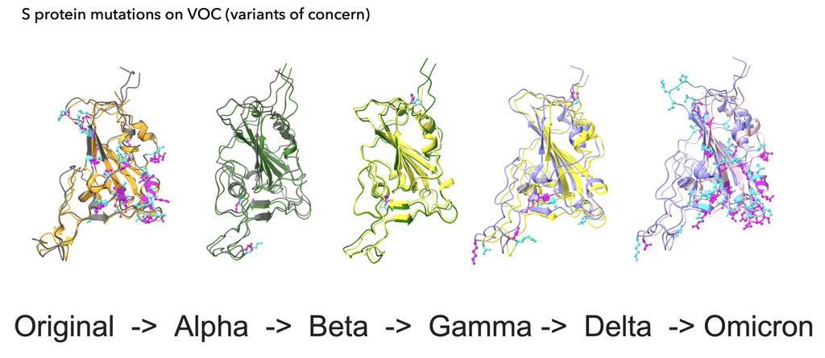

Slide 13
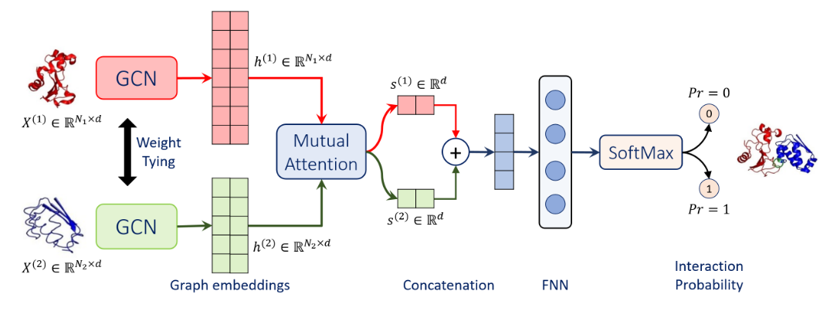
Conclusion & Future Scope
As the vaccinations increasing day by day and other facts influence the change in the Effect rate. It is not possible to estimate the future cases.
In order to over come this, we need to conduct further research on the study on the mechanism of SARS-CoV-2 Spike protein binding with ACE2 helps for further research to drug design and treatments for COVID-19 and other coronavirus caused diseases.
According to Data Science we can go for binding behavior and pattern matching of various protein structures using Machine Learning Techniques by using Biotite, PyTorch and TorchDrug.
A PyTorch implementation of GCN with mutual attention for protein-protein interaction prediction the two graph convolutional networks (GCNs) and Feed-forward Neural networking with weight sharing, and a mutual attention network to extract relevant geometric features related to query protein pairs.

Slide 14
DATABASES
https://gisaid.org/
https://www.rcsb.org/

Slide 15

Thank you

Slide 16

NAME:RAVI POTALAPALLI
Outlook:rpotlapa@students.Kennesaw.edu
Gmail:potlapalliravi2021@gmail.com
Mobile: +1 6788587696
LinkedIn: https://www.linkedin.com/in/ravi-potlapalli-a9b171191

